Slide 1
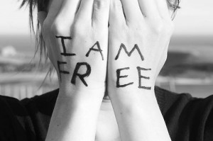
Stephen George’s Significant Event Timeline
Fourth Grade
Confidence
First theatre experience
Advanced math
4th grade girlfriend
Summer 2012
Mission trip
Relationship with God
Driver’s License
First Car
Independence
Came out
Moved in to UC
Saying goodbye
New opportunities
Independence
Young Life
Expenses
Calc II
Senior Year
Leadership opportunities
Incredible friends
Impactful classes
Youth pastor moved
Tough break-up
2004
2014
First part-time job
First consistent income
Increase in stress
Responsibility
Forced to develop better people skills
Moved to a new school
Making all new friends
Academic trouble
Incredible teachers

